Slide 1




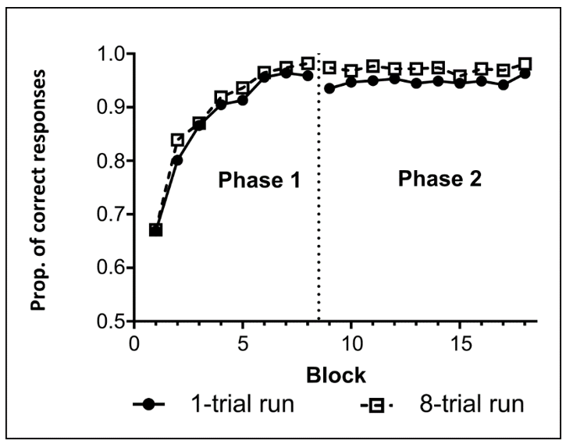
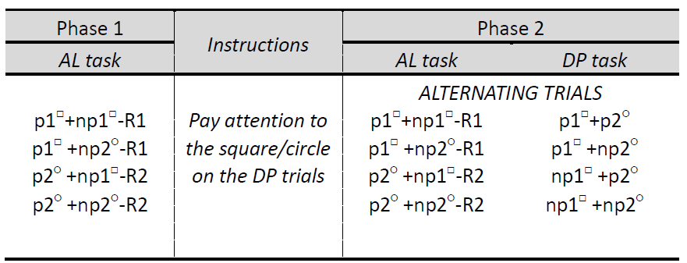
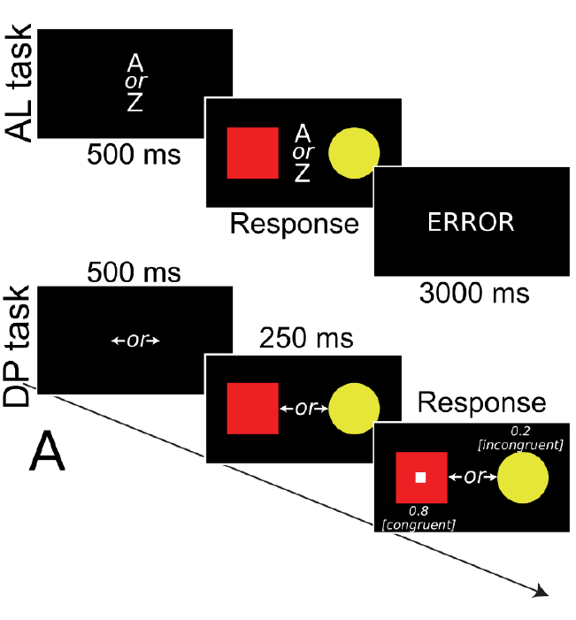
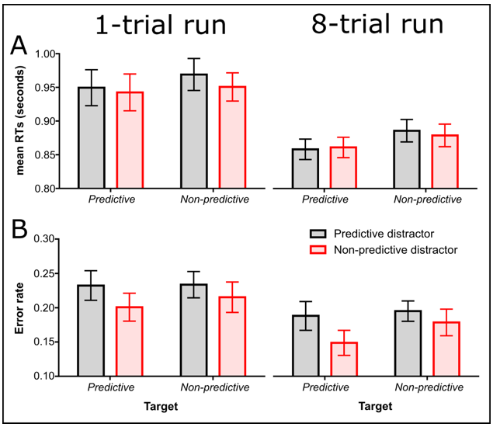
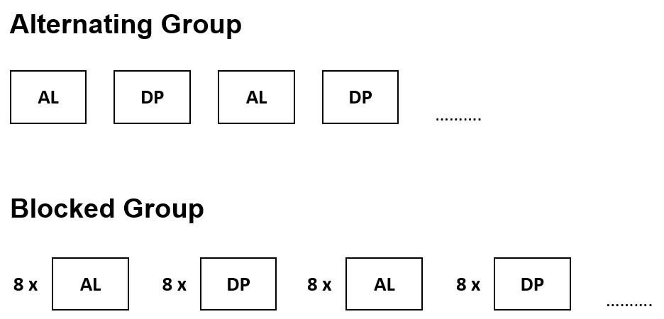
Testing the automaticity of predictiveness-driven attention: The effect of task difficulty
Mina Jevtović¹, Tom Beesley^{3,4} & David Luque^{1,2,4}
¹Universidad Autónoma de Madrid, Madrid, Spain
²Universidad de Málaga, Spain
³Lancaster University, UK
⁴UNSW Sydney, Australia
Predictiveness-driven attention
Associative learning (learning new cue-outcome pairings) produces changes in attention (Kruschke, 2003; Le Pelley, 2004)
Cues that are good predictors of relevant outcomes are prioritized to those that are non-predictive/redundant
Predictible outcome
Unpredictable outcome
The exact nature of the predictiveness-driven attention is still debated in the literature
TWO DIFFERENT VIEWS
- - - - - - - - -
- - - - - - - - -
PREDICTIVENESS-DRIVEN ATTENTION
?
VOLUNTARY
(Mitchell et al., 2012)
AUTOMATIC
(Le Pelley et al., 2013)
Current Study
Is predictiveness-driven attention automatic or voluntary in nature?
How does task difficulty affect predictiveness-driven attention?
Methods
Results
Participants
Associative Learning Task
N = 104 undergraduate students
Mean proportion of correct responses in the associative learning task in both groups of participants
2 groups (1-trial & 8-trial group)
Design
p1, p2
predictive cues
np1, np2
non-predictive cues
R1, R2
correct responses in AL
that participants learned to make correct responses in both groups
Dot-Probe Task
Procedure
main effect of run length
F(1, 94) = 15.92, p < .001, ηp2 = 0.145
(faster RTs for the 8-trial run
than 1-trial run group)
main effect of target predictiveness
F(1, 94) = 5.51, p = .021, ηp2 = 0.055
(faster RTs when the instructed shape
was in a predictive
colour than in a
non-predictive colour)
Associative Learning Task (AL)
+
1-trial run group
8-trial run group
Conclusion
Even when tasks differ in difficulty, participants prioritize predictive over non-predictive cues. This finding, along others (participants attend to the colour despite its irrelevance, explicit instructions given before the task) suggest that predictiveness-driven attention is at least partly involuntary.
References
Le Pelley, M., Vadillo, M., & Luque, D. (2013). Learned predictiveness influences rapid attentional capture: Evidence from the dot probe task. Journal Of Experimental Psychology: Learning, Memory, And Cognition, 39(6), 1888-1900.
Mitchell, C. J., Griffiths, O., Seetoo, J., & Lovibond, P. F. (2012). Attentional mechanisms in learned predictiveness. Journal of Experimental Psychology: Animal Behavior Processes, 38(2), 191-202.
Le Pelley, M. (2004). The Role of Associative History in Models of Associative Learning: A Selective Review and a Hybrid Model. The Quarterly Journal Of Experimental Psychology Section B, 57(3b), 193-243
Kruschke, J. (2003). Attention in Learning. Current Directions In Psychological Science, 12(5), 171-175.

